Slide 1
Word of Faith Christian Center
Saturday, October 24th
3:00 p.m. – 8:00 p.m.

Slide 2
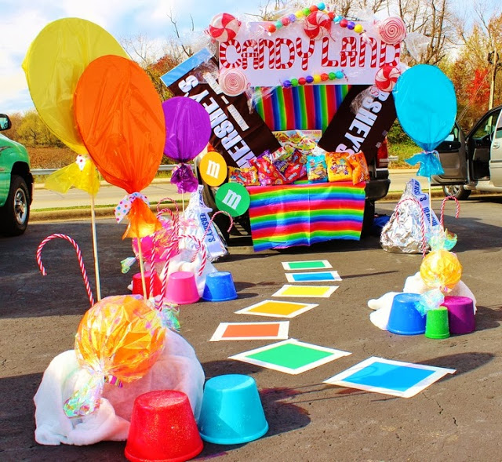
Choose your Theme
..Theme Ideas..
Candy Land
Ninja Turtles
Sesame Street
Noah’s Art
Veggie Tales
Star Wars…
Foot Ball
Basket Ball
Soccer
Cricket

Slide 3
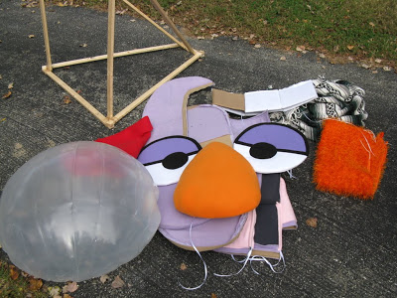
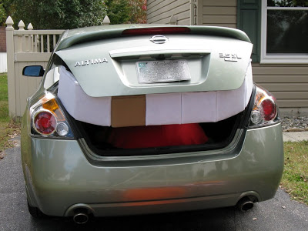
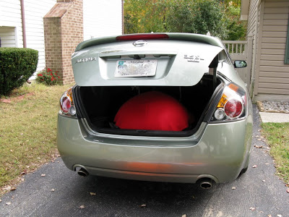
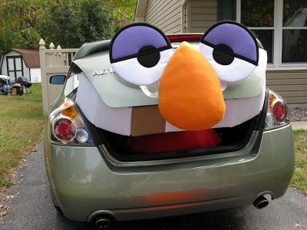
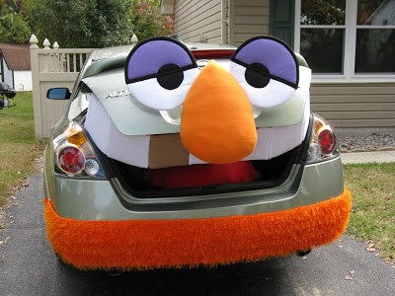
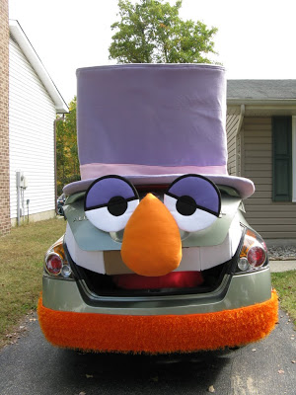
Prepare your Decorations

Slide 4
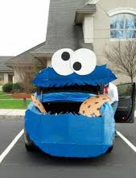
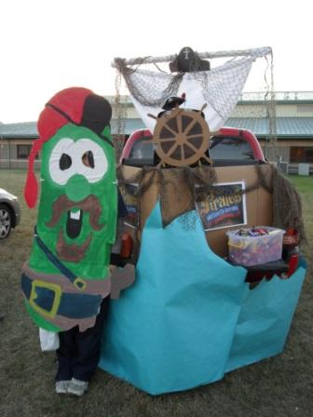
Execute your Plan
Veggie Tales
Sesame Street
Characters

Slide 5
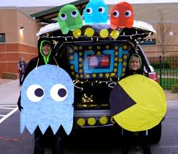
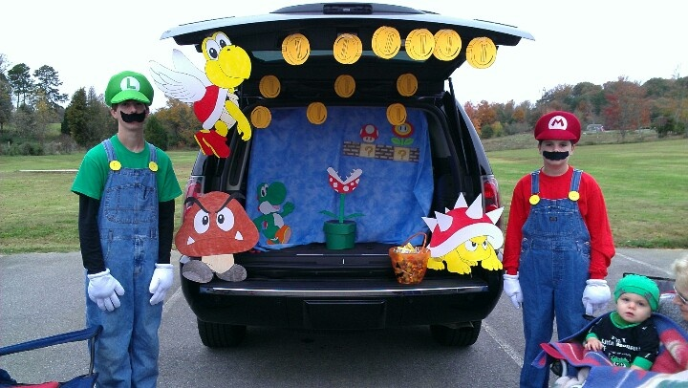
Mario
Brothers
Pac Man

Slide 6
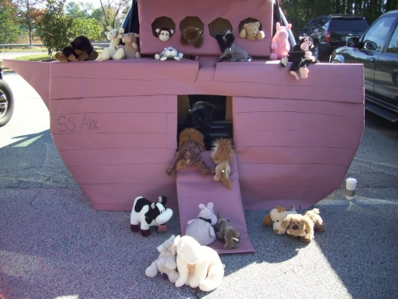
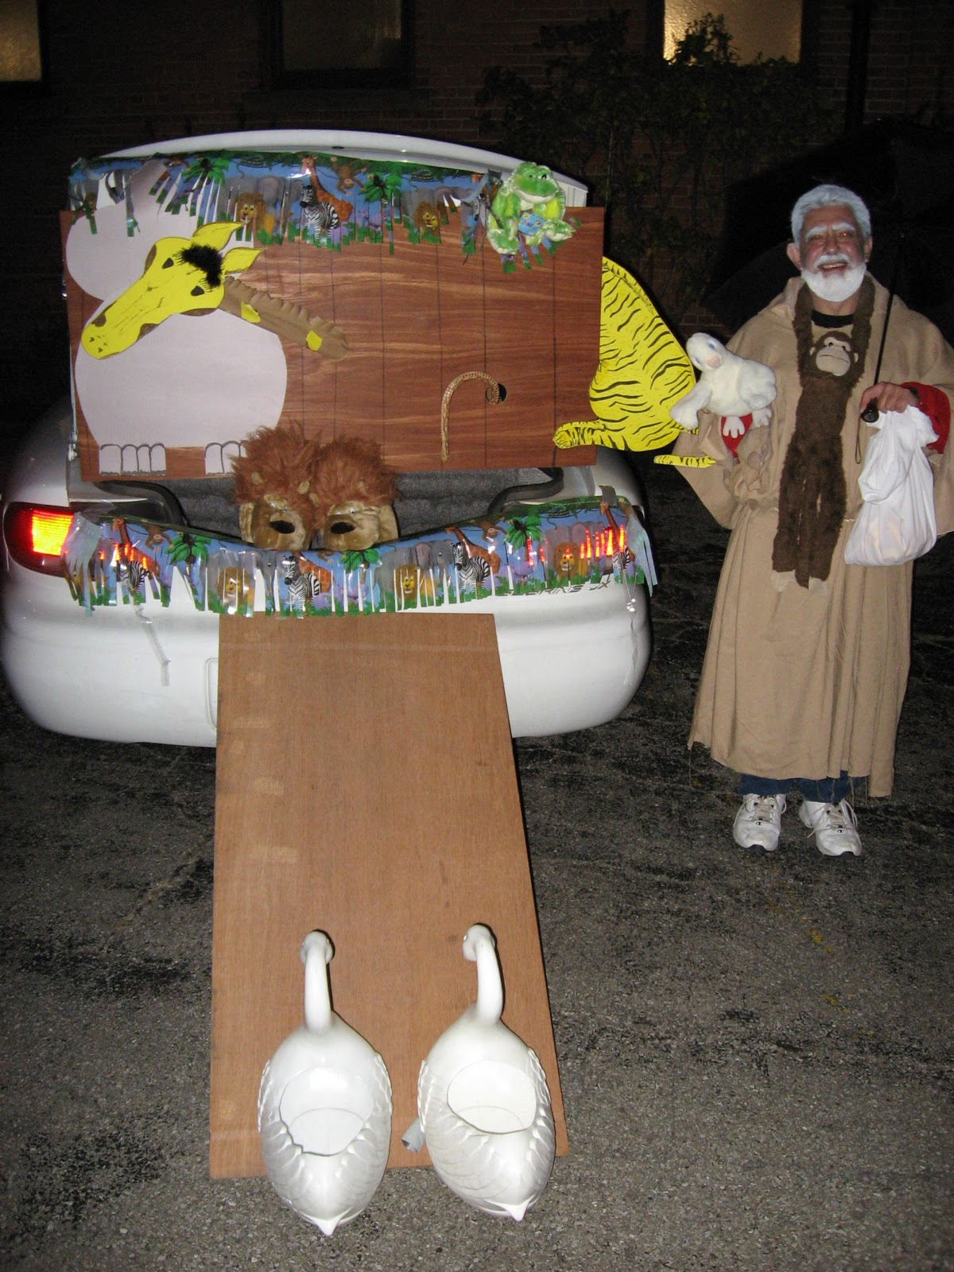
Noah’s Ark

Slide 7
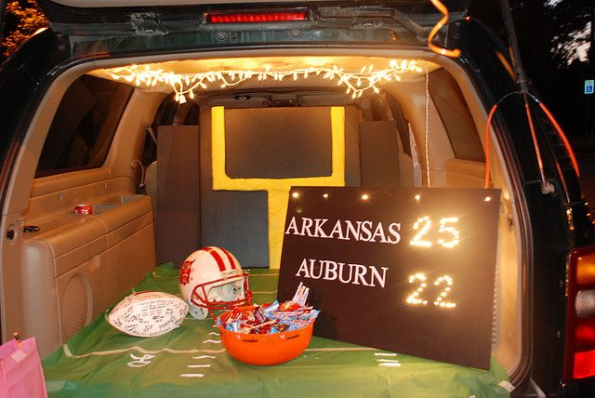
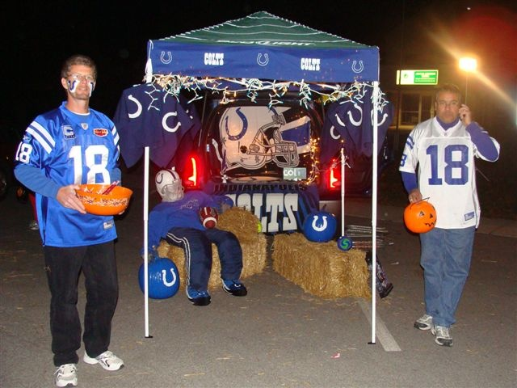
Sports Theme

Slide 8
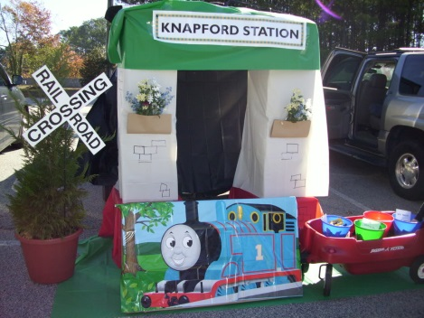
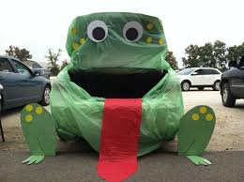
Be Creative
Have Fun
Be a Blessing

Slide 9
Word of Faith Christian Center
Saturday, October 24th
3:00 p.m. – 8:00 p.m.

